Slide 1
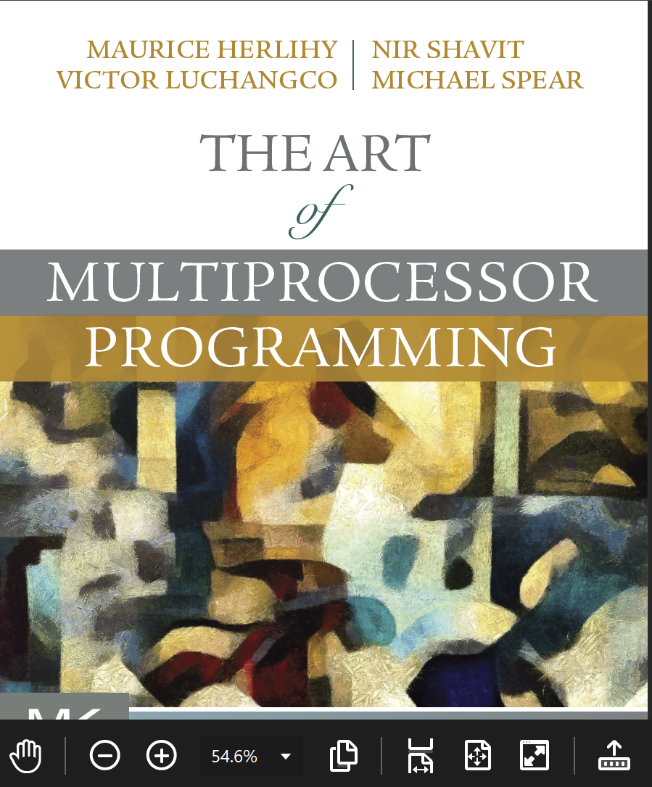
Multiprocessor Architecture Basics
Companion slides for
The Art of Multiprocessor Programming
by Maurice Herlihy, Nir Shavit, Victor Luchangco, and Michael Spear
TexPoint fonts used in EMF.
Read the TexPoint manual before you delete this box.: AAAA
Notes:
1

Slide 2
Multiprocessor Architecture
Abstract models are (mostly) OK to understand algorithm correctness and progress
To understand how concurrent algorithms actually perform
You need to understand something about multiprocessor architectures
Notes:
We look at how multiprocessor hardware architecture affects the design of efficient concurrent data structures and algorithms. We identify basic components, describe what they do, how they interact, and why some activities that appear fast and simple may sometimes be slow and complex. Mulitprocessors present a nice, simple high-level abstraction:
processors read and write values from a shared memory. Unfortunately, this high-level abstraction can be misleading when trying to understand how concurrent algorithms and data.
structures perform in practice.
Instead, understanding performance requires understanding some of the basic
mechanisms residing ``under the hood'' of modern multiprocessor architectures.

Slide 3
Pieces
Processors
Threads
Interconnect
Memory
Caches

Slide 4
Old-School Multiprocessor
cache
cache
cache
Bus
Bus
memory
Notes:
Instead of having one processor per chip, as in traditional architectures …

Slide 5
Old School
Processors on different chips
Processors share off chip memory resources
Communication between processors typically slow
Notes:
The important issue about multicore architectures, however,

Slide 6
Multicore Architecture
cache
cache
cache
cache
Bus
Bus
memory
Notes:
Multicore architectures put multiple processors on a single chop.

Slide 7
Multicore
All Processors on same chip
Processors share on chip memory resources
Communication between processors now very fast
Notes:
The important issue about multicore architectures, however,

Slide 8
SMP vs NUMA
memory
SMP
NUMA
SMP: symmetric multiprocessor
NUMA: non-uniform memory access
CC-NUMA: cache-coherent …
(1)
Notes:
In an SMP architecture, both processors and memory hang off a bus. This works well for small-scale systems. In a NUMA (non-uniform memory access) architecture, each processor has its own piece of the memory. Accessing your own memory is relatively fast, and accessing someone else’s is slower. Usually NUMA machines also have caches, in which case they are called CC-NUMA machines, for cache-coherent NUMA.

Slide 9
Future Multicores
Short term: SMP
Long Term: most likely a combination of SMP and NUMA properties
Notes:
The important issue about multicore architectures, however,

Slide 10
Understanding the Pieces
Lets try to understand what the pieces that make the multiprocessor machine are
And how they fit together

Slide 11
Processors
Cycle:
  Fetch and execute one instruction
Cycle times change
  1980: 10 million cycles/sec
  2005: 3,000 million cycles/sec
Notes:
When discussing multiprocessor architectures, the basic unit of time is the cycle: the time it takes a processor to fetch and execute a single instruction. In absolute terms, cycle times change as technology advances (from about 10 million cycles per second in 1980 to about 3,000 million in 2005), and they vary from one platform to another
(Processors that control toasters have longer cycles than processors that control web servers). Nevertheless, the relative cost of operations such as memory access changes slowly when expressed in terms of cycles.

Slide 12
Computer Architecture
Measure time in cycles
  Absolute cycle times change
Memory access: ~100s of cycles
  Changes slowly
  Mostly gets worse
Notes:
We measure memory access times in cycles, not absolute time. Because memory access times

Slide 13
Threads
Execution of a sequential program
Software, not hardware
A processor can run a thread
Put it aside
  Thread does I/O
  Thread runs out of time
Run another thread
Notes:
A thread is a sequential program. While a processor is a hardware device, a thread is a software construct. A processor can run a thread for a while and then set it aside and run another thread. A processor may set aside a thread for a variety of reasons. Perhaps the thread has issued a memory request that will take some time to satisfy, or perhaps that thread has simply run long enough, and it is time for another thread to make progress. When a thread is suspended, it may resume execution on another processor.

Slide 14
Analogy
You work in an office
When you leave for lunch, someone else takes over your office.
If you don’t take a break, a security guard shows up and escorts you to the cafeteria.
When you return, you may get a different office
Notes:
By analogy, you (a thread) are working in an office (a processor). Whenever you step out to eat lunch or mail a letter, someone else moves in and uses your office while you are gone. Every now and then a security guard forcibly escorts you to the cafeteria or
bathroom so someone else can have a chance to use your office. When you return, you may be put in a different office.

Slide 15
Interconnect
Bus
  Like a tiny Ethernet
  Broadcast medium
  Connects
    Processors to memory
    Processors to processors
Network
  Tiny LAN
  Mostly used on
  large machines
memory
SMP
Notes:
Multirprocessors rely on some kind of interconnect. Usually processors and memory are connected by a bus, which you can think of as a tiny Ethernet. It is a broadcast medium: if one processor sends a message, all the processors and the memory can receive it. Larger machines use a network in which packets are sent point-to-point, like a small local area netowrk.

Slide 16
Interconnect
Interconnect is a finite resource
Processors can be delayed if others are consuming too much
Avoid algorithms that use too much bandwidth
Notes:
When you are designing a concurrent algorithm or data structure, you don’t need to know the details of how the interconnect works. All you need to know is that interconnect bandwidth is a finite resource, and if your algorithm causes a lot of traffic, it won’t perform very well.

Slide 17

Processor and Memory are Far Apart
memory
interconnect
processor
Notes:
From our point of view, one architectural principle drives everything else: processors and memory are far apart.

Slide 18
Reading from Memory
address
Notes:
It takes a long time for a processor to read a value from memory. It has to send the address to the memory …

Slide 19
Reading from Memory
zzz…
Notes:
Wait for the message to be delivered …

Slide 20
Reading from Memory
value
Notes:
And wait or the response to come back.

Slide 21
Writing to Memory
address, value
Notes:
Writing is similar, except you send the address and the new value, …

Slide 22
Writing to Memory
zzz…
Notes:
Wait …

Slide 23
Writing to Memory
ack
Notes:
And then get an acknowledgement that the new value was actually installed in the memory.

Slide 24
Cache: Reading from Memory
address
cache
Notes:
We alleviate this problem by introducing one or more caches: small, fast memories situated between main memory and processors.

Slide 25
Cache: Reading from Memory
cache
Notes:
Now, when a processor reads a value from memory, it stores the data in the cache before returning the data to the processor.

Slide 26
Cache: Reading from Memory
cache
Notes:
Later, if the processor wants to use the same data …

Slide 27
Cache Hit
?
cache
Notes:
When a processor wants to read a value, it first checks whether the data is present in the cache …

Slide 28
Cache Hit
Yes!
cache
Notes:
If so, it reads directly from the cache, saving a long round-trip to main memory. We call this a cache hit.

Slide 29
Cache Miss
address
?
No…
cache
Notes:
Sometimes the processor doesn’t find what it is lookin for in the cache.

Slide 30
Cache Miss
cache
Notes:
We call this a cache miss.

Slide 31
Cache Miss
cache

Slide 32
Local Spinning
With caches, spinning becomes practical
First time
  Load flag bit into cache
As long as it doesn’t change
  Hit in cache (no interconnect used)
When it changes
  One-time cost
  See cache coherence below
Notes:
We will discuss the ideas in this slide when talking about spin-locks

Slide 33
Granularity
Caches operate at a larger granularity than a word
Cache line: fixed-size block containing the address (today 64 or 128 bytes)
Notes:
caches typically operate at a granularity larger than a single word: a cache holds a group of neighboring words called a cache line. (sometimes called a cache block).

Slide 34
Locality
If you use an address now, you will probably use it again soon
  Fetch from cache, not memory
If you use an address now, you will probably use a nearby address soon
  In the same cache line

Slide 35
Hit Ratio
Proportion of requests that hit in the cache
Measure of effectiveness of caching mechanism
Depends on locality of application

Slide 36
L1 and L2 Caches
L2
L1
Notes:
In practice, most processors have two levels of caches, called the L1 and L2 caches.

Slide 37
L1 and L2 Caches
L2
Small & fast
1 or 2 cycles
L1
Notes:
The L1 cache typically resides on the same chip as the processor, and takes one or two cycles to access.

Slide 38
L1 and L2 Caches
Larger and slower
10s of cycles
~128 byte line
L2
L1
Notes:
The L2 cache often resides off-chip, and takes tens of cycles to access. Of course, these times vary from platform to platform, and many multiprocessors have even more elaborate cache structures.

Slide 39
When a Cache Becomes Full…
Need to make room for new entry
By evicting an existing entry
Need a replacement policy
  Usually some kind of least recently used heuristic
Notes:
When a cache becomes full, it is necessary to evict a line, discarding it if it has not been modified, and writing it back to memory if it has. A replacement policy determines which cache line to replace. Most replacement policies try to evict the least recently used line.

Slide 40
Fully Associative Cache
Any line can be anywhere in the cache
  Advantage: can replace any line
  Disadvantage: hard to find lines

Slide 41
Direct Mapped Cache
Every address has exactly 1 slot
  Advantage: easy to find a line
  Disadvantage: must replace fixed line

Slide 42
K-way Set Associative Cache
Each slot holds k lines
  Advantage: pretty easy to find a line
  Advantage: some choice in replacing line

Slide 43
Multicore Set Associativity
k is 8 or even 16 and growing…
  Why? Because cores share sets
  Threads cut effective size if accessing different data

Slide 44
Cache Coherence
A and B both cache address x
A writes to x
  Updates cache
How does B find out?
Many cache coherence protocols in literature

Slide 45
MESI
Modified
  Have modified cached data, must write back to memory
Notes:
Here we describe one of the simplest coherence protocols. A cache line can be in one of 4 states. If it is modified, then the cache line has been updated in the cache, but not yet in memory, so this value must be written back to memory before anyone can use it. If the

Slide 46
MESI
Modified
  Have modified cached data, must write back to memory
Exclusive
  Not modified, I have only copy
Notes:
If the cache line is exclusive, then we know no other processor has it cached. This means that if we decide to modify it, we don’t need to tell anyone else.

Slide 47
MESI
Modified
  Have modified cached data, must write back to memory
Exclusive
  Not modified, I have only copy
Shared
  Not modified, may be cached elsewhere
Notes:
If the line is shared, then we have not modified it, moreover other processors may also have this value cached. If we decide to modify this cache line, we must tell the other processors to invalidate (discard) their cached copies, because otherwise they will have out-of-date values.

Slide 48
MESI
Modified
  Have modified cached data, must write back to memory
Exclusive
  Not modified, I have only copy
Shared
  Not modified, may be cached elsewhere
Invalid
  Cache contents not meaningful
Notes:
Finally, the cache line may be invalid, meaning that the cached value is no longer meaningful (perhaps because some other processor updated it).

Slide 49
Processor Issues Load Request
load x
cache
cache
cache
Bus
Bus
memory
data

Slide 50
Memory Responds
E
cache
cache
cache
Bus
Bus
Got it!
memory
data
data
Notes:
When a processor loads a data value x, it broadcasts the request on the bus. The memory controller picks up the message and sends the data back. The processor marks the cache line as exclusive.

Slide 51
Processor Issues Load Request
Load x
E
data
cache
cache
Bus
Bus
memory
data
Notes:
Now a second processor wants to load the same address, so it broadcasts a request.

Slide 52
Other Processor Responds
Got it
S
S
E
data
data
cache
cache
Bus
Bus
memory
data
Notes:
When the second processor asks for x, the first one, who is snooping on the bus, responds with the data. (It can respond faster than the memory). Both processors mark that cache line as shared.

Slide 53
Modify Cached Data
S
S
data
data
data
cache
Bus
memory
data

Slide 54
Write-Through Cache
Write x!
S
S
data
data
cache
data
data
Bus
Bus
memory
data

Slide 55
Write-Through Caches
Immediately broadcast changes
Good
  Memory, caches always agree
  More read hits, maybe
Bad
  Bus traffic on all writes
  Most writes to unshared data
  For example, loop indexes …

Slide 56
Write-Through Caches
Immediately broadcast changes
Good
  Memory, caches always agree
  More read hits, maybe
Bad
  Bus traffic on all writes
  Most writes to unshared data
  For example, loop indexes …
“show stoppers”

Slide 57
Write-Back Caches
Accumulate changes in cache
Write back when line evicted
  Need the cache for something else
  Another processor wants it

Slide 58
Invalidate
Invalidate x
S
S
M
I
data
data
cache
cache
Bus
Bus
memory
data

Slide 59
Recall: Real Memory is Relaxed
Remember the flag principle?
  Alice and Bob’s flag variables false
Alice writes true to her flag and reads Bob’s
Bob writes true to his flag and reads Alice’s
One must see the other’s flag true

Slide 60
Not Necessarily So
Sometimes the compiler reorders memory operations
Can improve
  cache performance
  interconnect use
But unexpected concurrent interactions

Slide 61
Write Buffers
address
Absorbing
Batching
Notes:
Many processors have write buffers. When a processor issues a write, it isn’t necessarily sent to memory right away. Instead it may be queued up in a write (or store) buffer. If the processor writes twice to the same location, the earlier write can be absorbed, that is, overwritten without

Slide 62
Volatile
In Java, if a variable is declared volatile, operations won’t be reordered
Write buffer always spilled to memory before thread is allowed to continue a write
Expensive, so use it only when needed

Slide 63
This work is licensed under a Creative Commons Attribution-ShareAlike 2.5 License.
You are free:
  to Share — to copy, distribute and transmit the work
  to Remix — to adapt the work
Under the following conditions:
  Attribution. You must attribute the work to “The Art of Multiprocessor Programming” (but not in any way that suggests that the authors endorse you or your use of the work).
  Share Alike. If you alter, transform, or build upon this work, you may distribute the resulting work only under the same, similar or a compatible license.
For any reuse or distribution, you must make clear to others the license terms of this work. The best way to do this is with a link to
  http://creativecommons.org/licenses/by-sa/3.0/.
Any of the above conditions can be waived if you get permission from the copyright holder.
Nothing in this license impairs or restricts the author's moral rights.

